Slide 1

ECE 281
Lesson 3
Maj Kevin Walchko
1

Slide 2
CE1

Slide 3
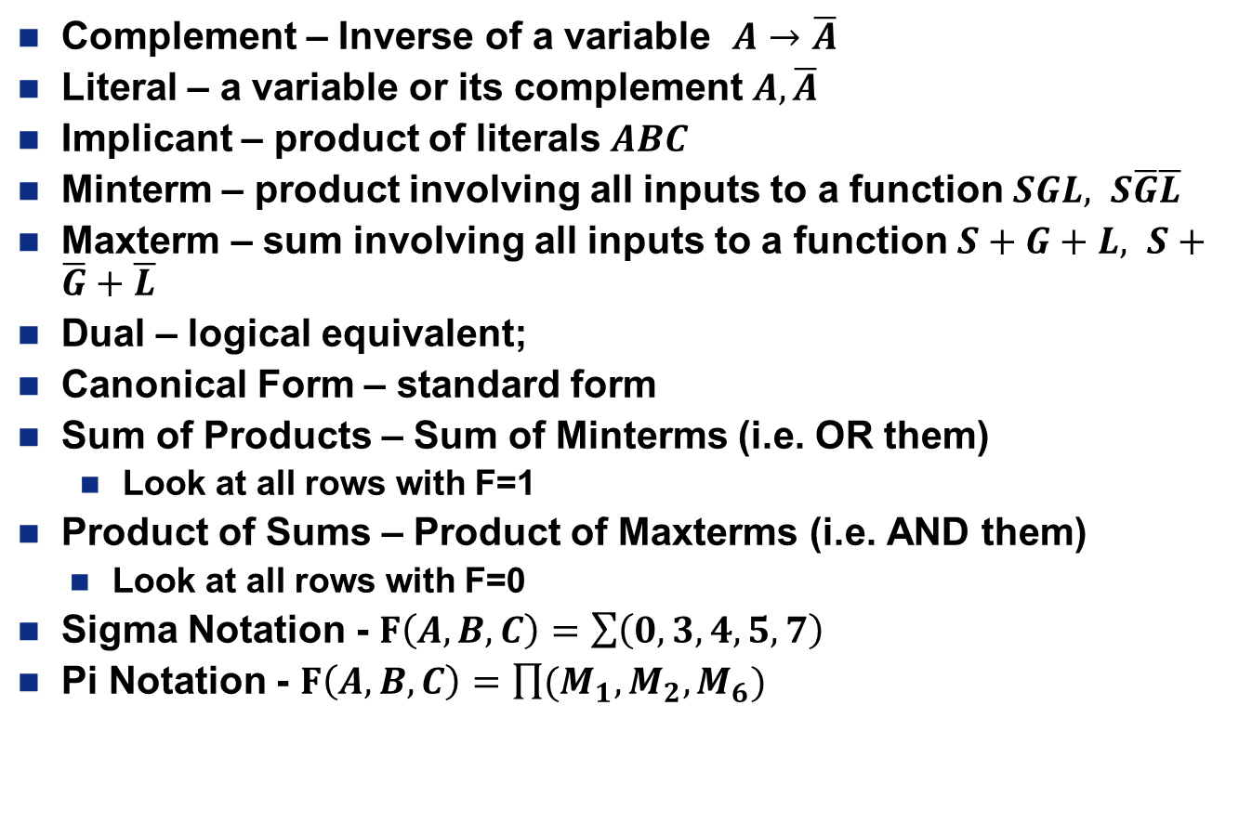
Vocabulary words
Complement – Inverse of a variable $A→\overline{A}$
Literal – a variable or its complement $A,\overline{A}$
Implicant – product of literals $ABC$
Minterm – product involving all inputs to a function $SGL, S\overline{G}\overline{L}$
Maxterm – sum involving all inputs to a function $S+G+L, S+\overline{G}+\overline{L}$
Dual – logical equivalent;
Canonical Form – standard form
Sum of Products – Sum of Minterms (i.e. OR them)
Look at all rows with F=1
Product of Sums – Product of Maxterms (i.e. AND them)
Look at all rows with F=0
Sigma Notation - $F\left(A,B,C\right)=\sum{\left(0,3,4,5,7\right)}$
Pi Notation - $F\left(A,B,C\right)=\prod{(M_{1},M_{2},M_{6})}$

Slide 4
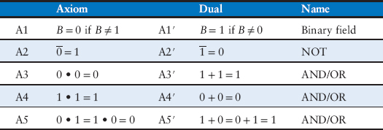
Axioms of Boolean Algebra

Slide 5
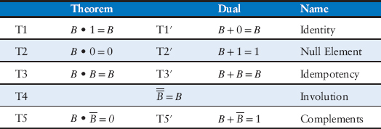
Boolean Algebra - Theorems of one Variable

Slide 6
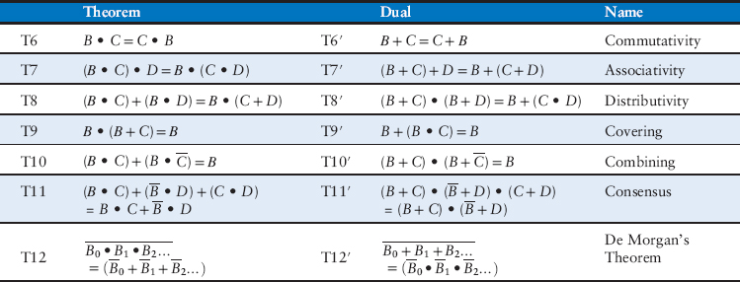
Boolean Algebra - Theorems of several variables

Slide 7
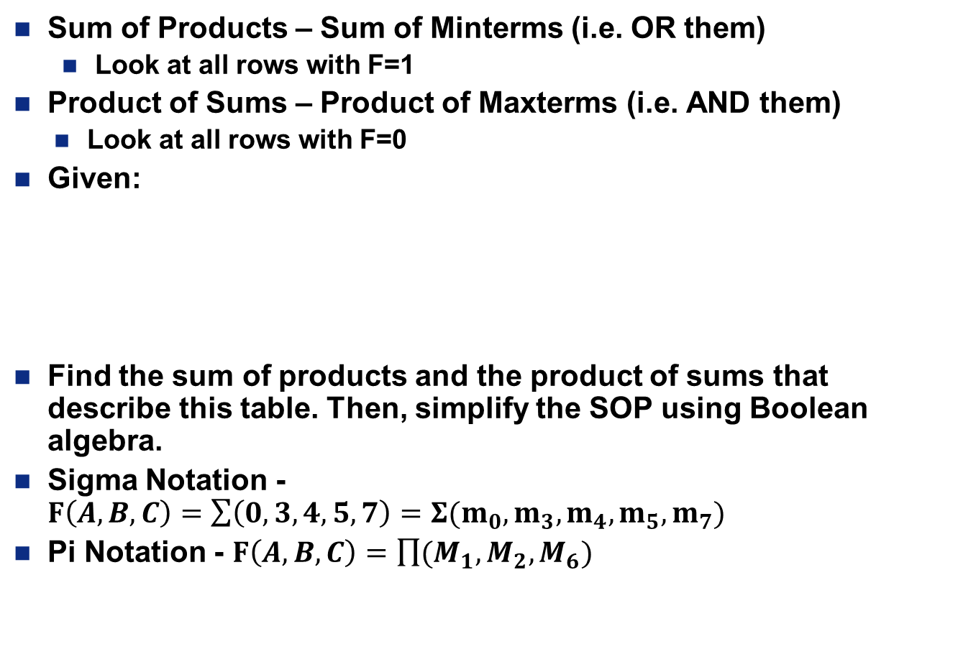
Examples
Sum of Products – Sum of Minterms (i.e. OR them)
Look at all rows with F=1
Product of Sums – Product of Maxterms (i.e. AND them)
Look at all rows with F=0
Given:
Find the sum of products and the product of sums that describe this table. Then, simplify the SOP using Boolean algebra.
Sigma Notation - $F\left(A,B,C\right)=\sum{\left(0,3,4,5,7\right)}=Σ(m_{0}, m_{3}, m_{4}, m_{5}, m_{7})$
Pi Notation - $F\left(A,B,C\right)=\prod{(M_{1},M_{2},M_{6})}$
A | B | C | F
0 | 0 | 0 | 1
0 | 0 | 1 | 0
0 | 1 | 0 | 0
0 | 1 | 1 | 1
1 | 0 | 0 | 1
1 | 0 | 1 | 1
1 | 1 | 0 | 0
1 | 1 | 1 | 1

Slide 8
Examples
Given: A house alarm with fire, burglar, and open door alerts. You want to raise the alarm is there is a fire or if there is a burglar and an open door.
Draw the associated truth table, write a logic expression, and draw the logic circuit to represent this scenario.

Slide 9
Git
Bitbucket.org
(origin or remote)
Since you are not doing distributed code dev, the amount of pull/push will be small
Pull (isolate)
Push (share)
Pull or init
Work in repo
Make changes
Commit
Repeat as necessary
Push
Add
Commit
(where you dev)
Your computer
Reference: http://rogerdudler.github.io/git-guide/

Slide 10

Math in Dec and Binary – Using an 8-Bit System
$\underline{\begin{aligned}−84 \\ +96\end{aligned}}$ $\underline{\begin{aligned} 96 \\ +31\end{aligned}}$
$\underline{\begin{aligned} −84 \\ −103\end{aligned}}$ $\underline{\begin{aligned} 96 \\ +32\end{aligned}}$

Slide 11
backups

Slide 12
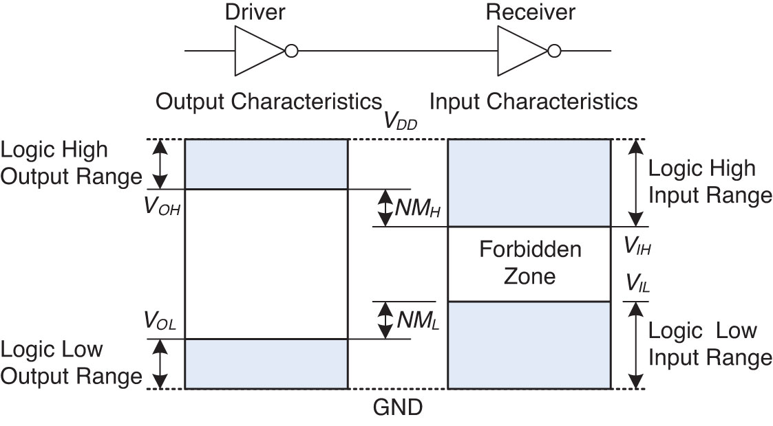
Voltage Levels and Noise Margins
Figure 1.23 Logic levels and noise margins

Slide 13
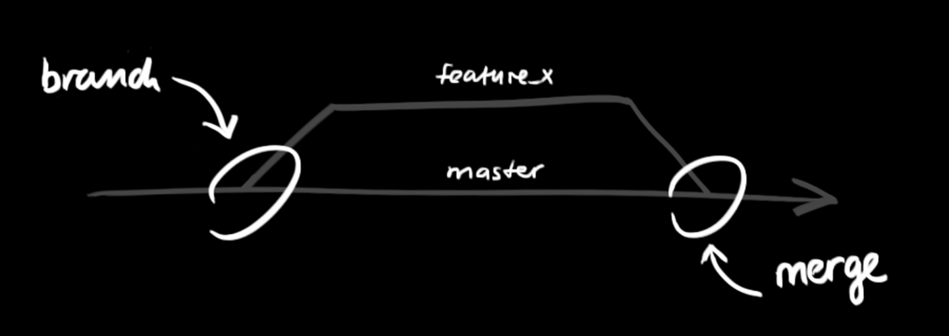
Git Workflow
Explanation: https://guides.github.com/introduction/flow/

Slide 14

Git
Reference: http://rogerdudler.github.io/git-guide/

